Slide 1


Datacation Day
Machine Learning Use Case: Brain Tumor

Slide 2
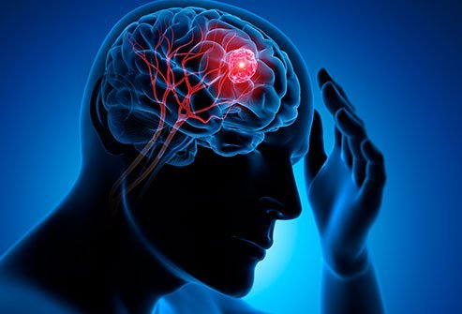
Introduction
Use Case
Brain tumours are very common and destructive. They lead to a shorter life if not diagnosed early enough.
Detecting a brain tumour is critical for the survival chance of the patient.
The Challenge
In total, 101 measurements of the brain have been collected of over 60.000 patients.
These features include both numerical and categorical values.
The target variable indicates whether the patient has a brain tumour.
We would like to predict the target variable.

Slide 3
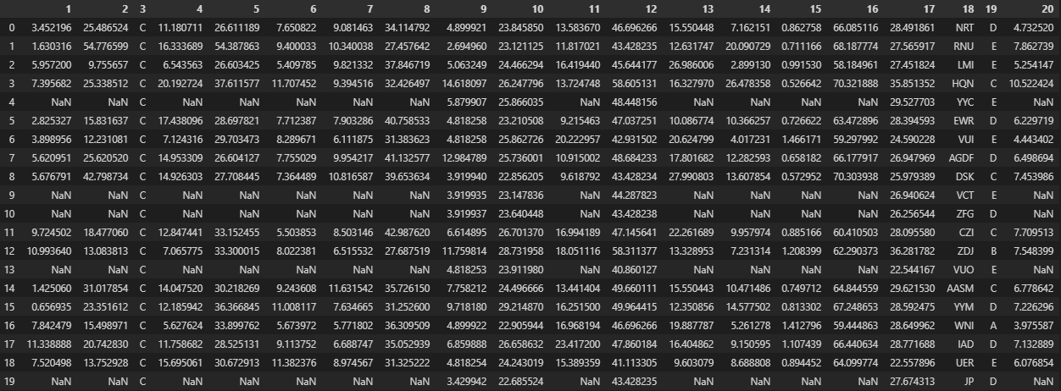
Data

Slide 4
Data
Train and test dataset
The full dataset consists of 60590 patients, 101 feature columns and 1 target column.
This dataset is split in a train dataset ‘train_brain.csv’ and a test dataset ‘test_brain.csv’.
The target has been removed in the test dataset.

Slide 5
Business Case
The hospital needs help with deciding which patients qualify for further research
The goal: detecting as much brain tumours as possible
However, due to the current health care crisis, resources are limited:
Selecting everyone for further research is not feasible
Selecting patients without a tumour for further research is a waste of resources
The hospital is interested in a model that optimizes this selection

Slide 6
Expected Result
Model
In this challenge, you will try out different Machine Learning models and Neural Networks. You will use the best model to predict whether patients have a brain tumour or not.

Slide 7
Technical Steps To Get Started
GitHub
The train and test datasets and the Python script to begin the challenge are located in a GitHub repository.
You need a GitHub account to download these files.
GitHub Desktop
To easily download the files from GitHub to your laptop, we recommend using GitHub Desktop.
Anaconda
Install Anaconda to easily open Jupyter Notebook

Slide 8
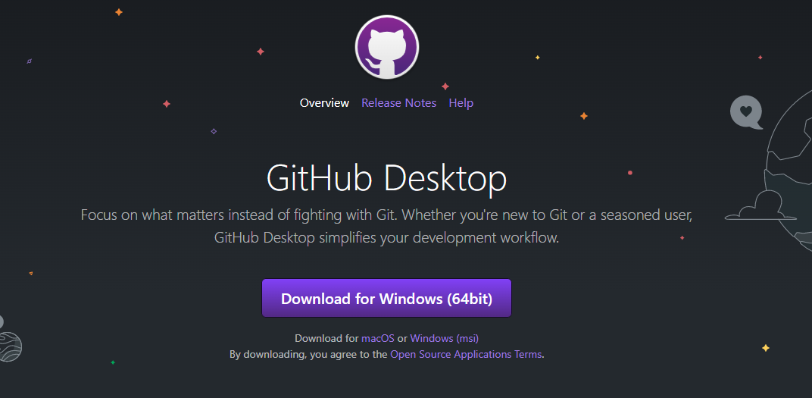
GitHub Desktop
Download
Go to desktop.github.com and download GitHub Desktop

Slide 9
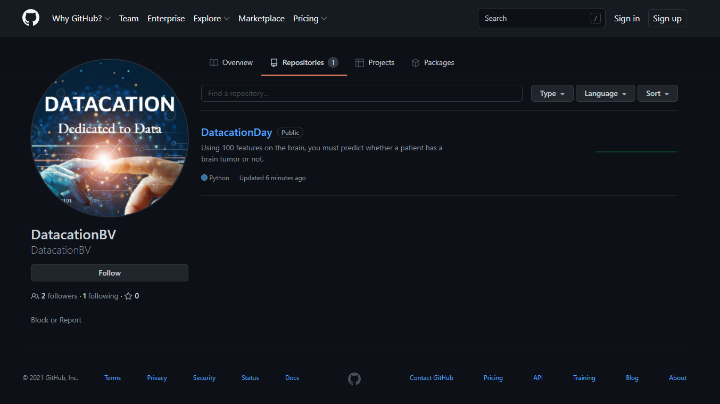
Download GitHub Code
Repository
Go to github.com/DatacationBV
Go to the ‘Repositories’ tab.
Click on the DatacationDay repository
Copy the URL, this should be: ‘https://github.com/DatacationBV/DatacationDay’

Slide 10
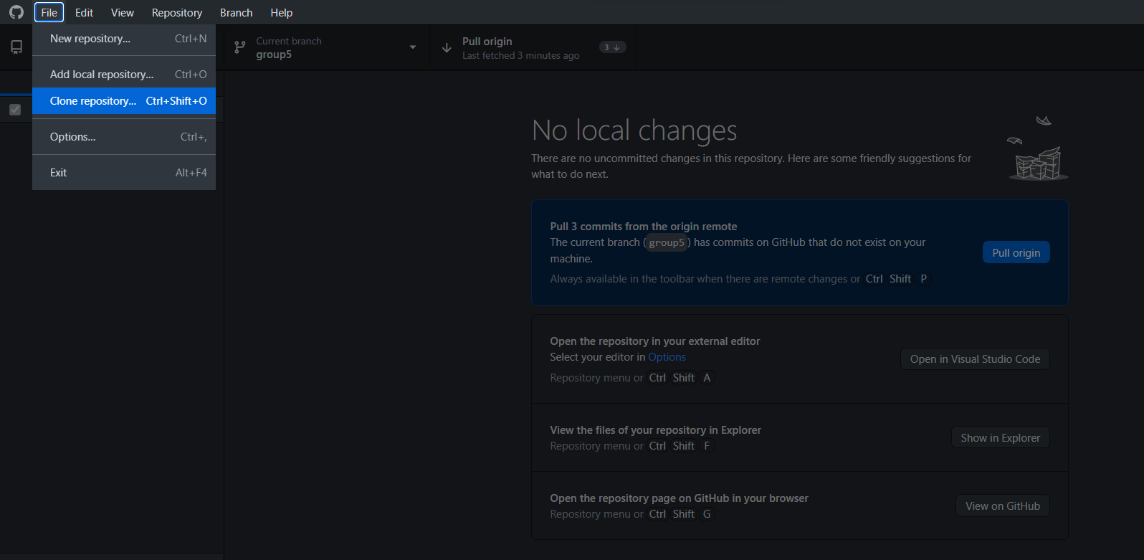
Download GitHub Code
Go to GitHub Desktop and in the File dropdown menu, select ‘Clone repository’.

Slide 11
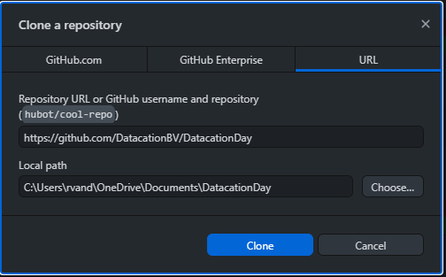
Download GitHub Code
Choose local folder
Select the URL tab and enter the copied URL as the repository URL.
Select a folder on your local machine to download the GitHub Code to.

Slide 12
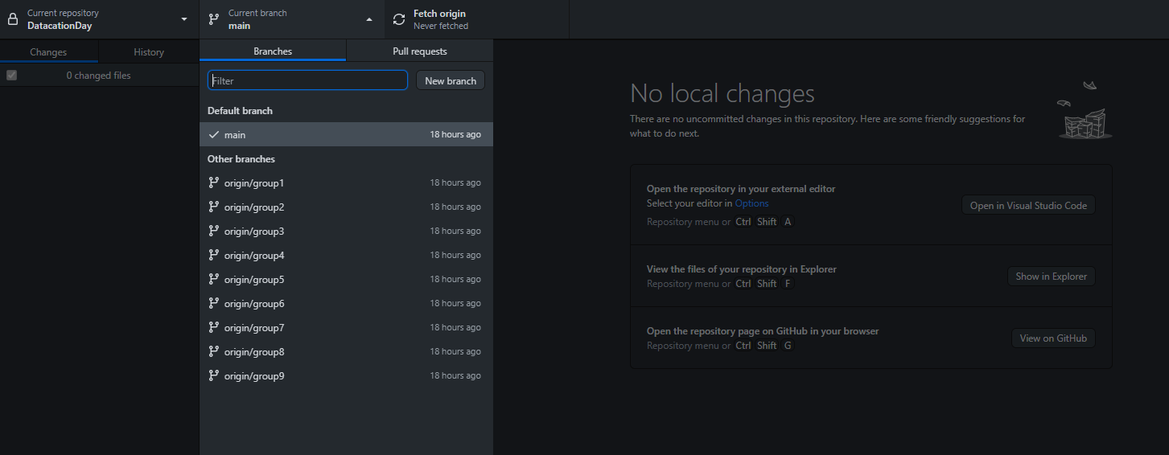
Start Coding In Your Group Branch
Select correct branch
Move to your group branch using the ‘current branch’ dropdown menu.

Slide 13
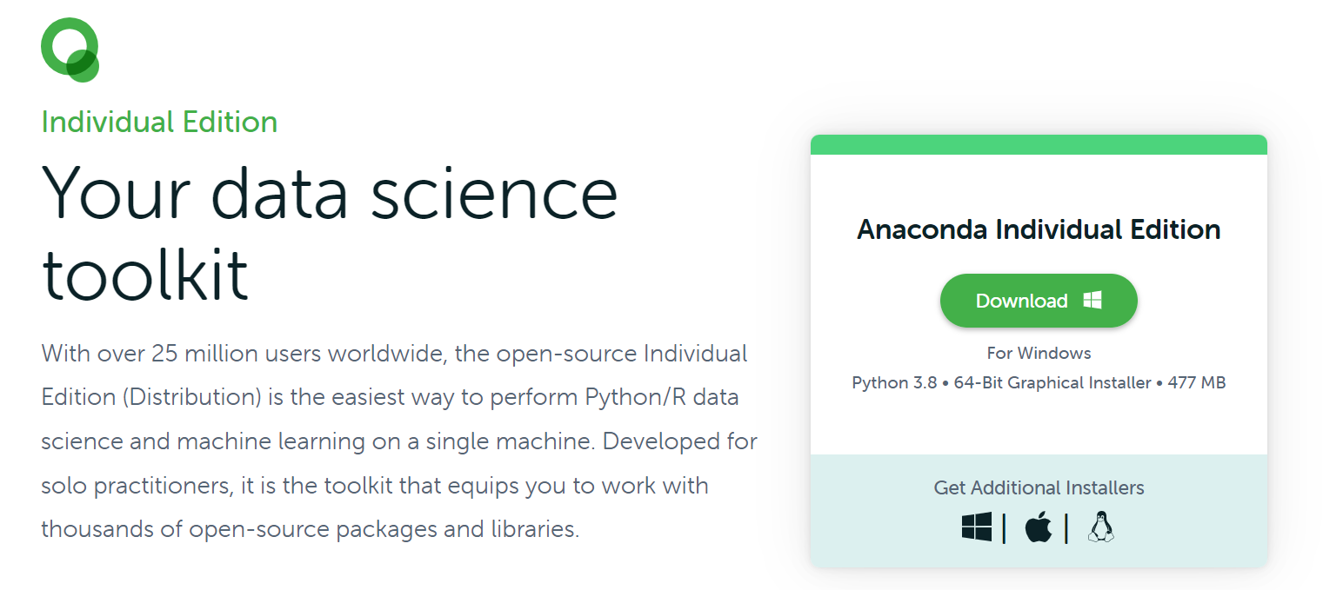
Install Anaconda
Go to https://www.anaconda.com/products/individual and Download Anaconda

Slide 14
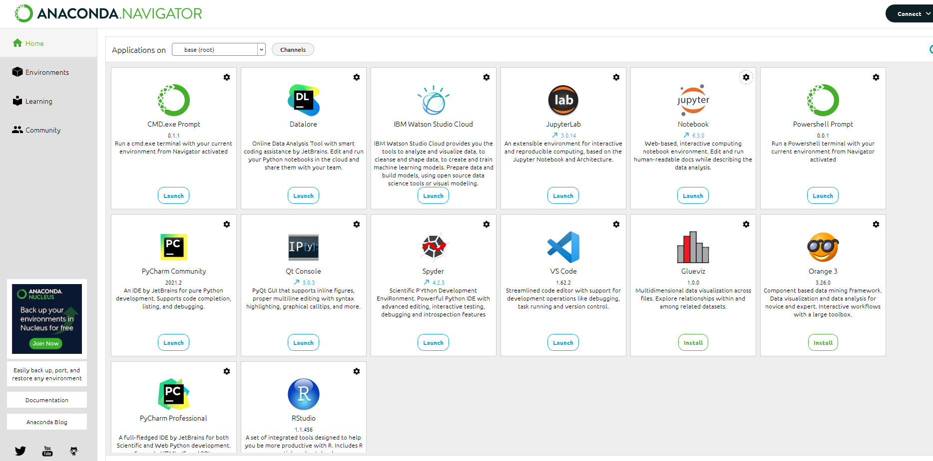
Open Jupyter Notebook
Open the Anaconda Navigator and launch Jupyter Notebook.
Navigate to the folder where you cloned the repository and start coding!

Slide 15
Timeline
Now – 12:00 Working on ML challenge
12:00 – 12:30 Lunch
12:30 – 13:30 Working on ML challenge
13:30 – 14:00 Presentation by Marcel Stoffels
14:00 – 14:30 Award ceremony
First read the complete challenge
Make an estimation of the time needed
If necessary, prioritize the exercises

Slide 16
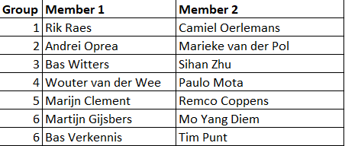
Groups

